Slide 1

Probability and Statistics
Han Min(hanm@bjut.edu.cn)
Office：3414 The Second Experimental Building
College of Applied Sciences
Beijing University of Technology
100124, Beijing P. R. China

Slide 2


Review
Marginal
Distribution Function
Marginal
Distribution
Marginal
Density

Slide 3
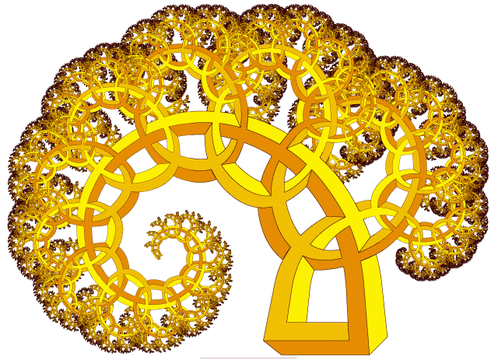
Chapter 3. Random vectors and Joint Probability Distributions
3.1 Two-Dimensional Variables and Joint Distributions
3.2 Marginal Distribution
3.3 Independent Random Variables
3.4 Distributions of Functions of
the Two-Dimensional Random Variables

Slide 4
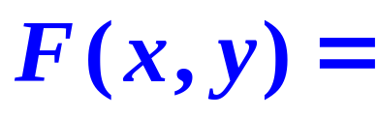
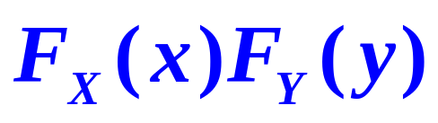
3.3 Independent Random Variables
Definition 3.3.1
independent
Suppose X,Y are two random variable
has joint distribution function F(x,y),
if for all x,y,
the two r.v. X and Y are independent.

Slide 5
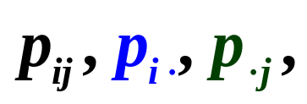
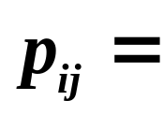
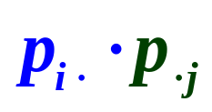
3.3 Independent Random Variables
Theorem 3.3.1
Suppose (X,Y) is a two-dimensional
discrete r.v. with the law of joint and
marginal distribution
1
then X and Y are independent if and
only if
for any i, j.

Slide 6
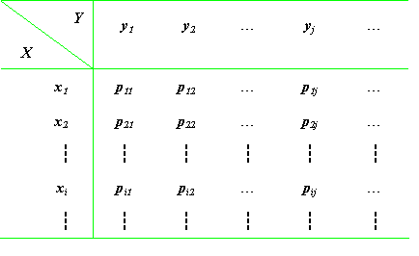
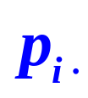

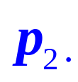

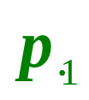
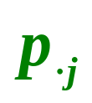
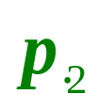

Law of joint distribution
Law of joint distribution

Slide 7
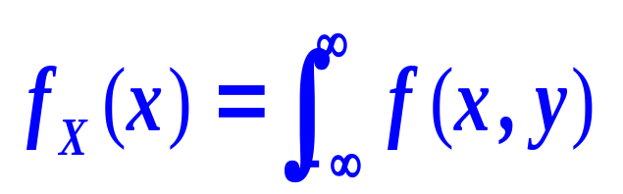

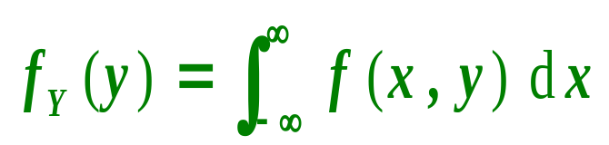
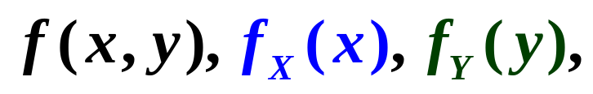
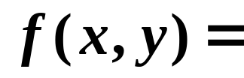
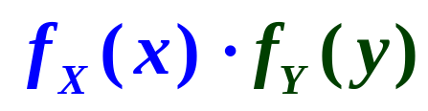
3.3 Independent Random Variables
Theorem 3.3.1
Suppose (X,Y) is a two-dimensional
continuous r.v. with the joint density
and marginal density distribution
2
respectively.
then X and Y are independent if and
only if

Slide 8





3.3 Independent Random Variables
Example 1
for any i, j.
Let X and Y have the joint probability distribution
Y
 | 0 | 1
0 | 0.1 | 0.2
1 | 0.4 | 0.2
2 | 0.1 | 0
X
Are discrete random variables X and Y independent?

Slide 9
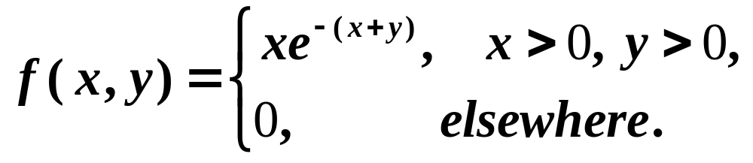
3.3 Independent Random Variables
Example 2
If the joint probability density of two r.v. is given by
Are continuous r.v. X and Y independent?

Slide 10
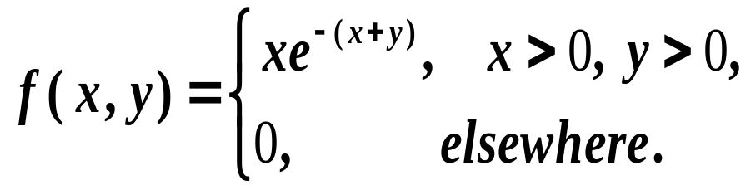
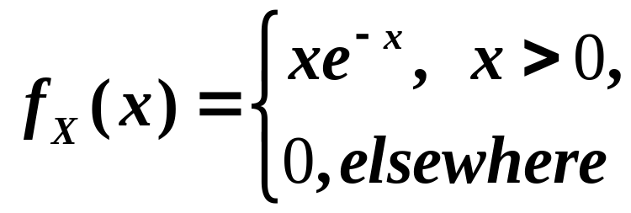
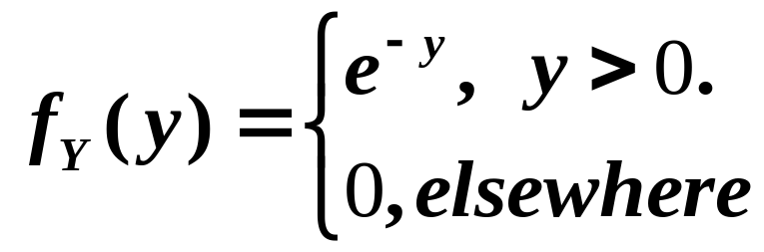
3.3 Independent Random Variables
Solve:
f (x, y)=f _{X}(x) f _{Y}(y)
for any x and y.
X,Y are independent.

Slide 11
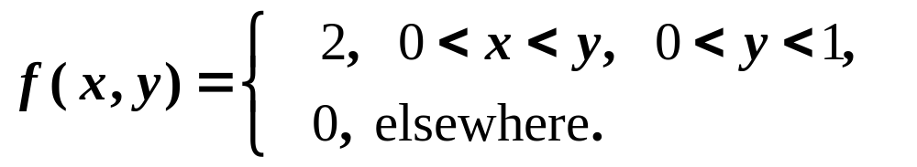
3.3 Independent Random Variables
Example 3
If the joint probability density of two r.v. is given by
Are continuous r.v. X and Y independent?

Slide 12
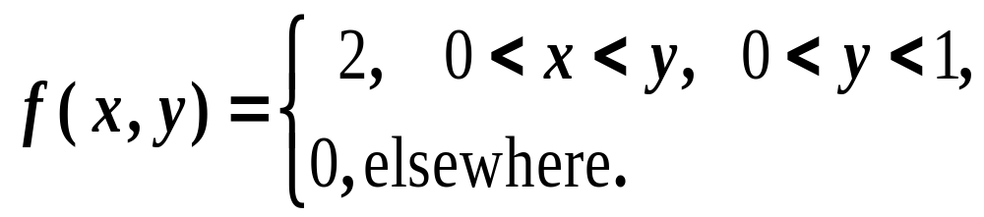
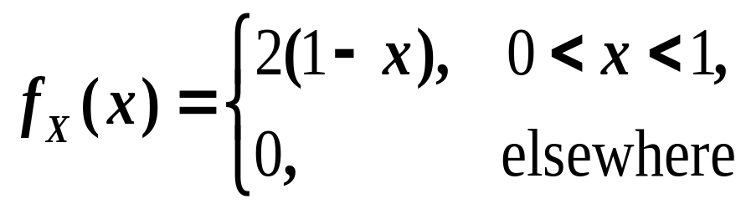
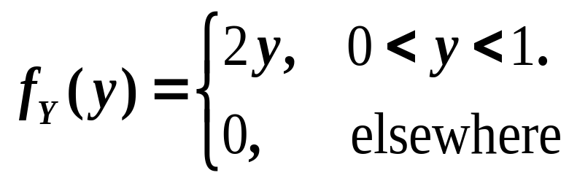

3.3 Independent Random Variables
Solve:
f (x, y)≠f _{X}(x) f _{Y}(y)
x and y.
X,Y are not independent.

Slide 13
Chapter 3. Random vectors and Joint Probability Distributions
3.1 Two-Dimensional Variables and Joint Distributions
3.2 Marginal Distribution
3.3 Independent Random Variables
3.4 Distributions of Functions of
the Two-Dimensional Random Variables

Slide 14




3.4 Distributions of Functions of
the Two-Dimensional Random Variables
X
AGE
Y
Z
Z=g(X,Y)

Slide 15
Contents
3.4 Distributions of Functions of
the Two-Dimensional Random Variables
“Max” and “Min” function
“Max” and “Min” function
3.4.1
Distribution of the sum of r.v.
3.4.2

Slide 16
3.4.1 “Max” and “Min” function
?
Question
Suppose that the random variables X,Y are independent,
the distribution function
is F_{X}(x) and F_{Y}(y), respectively.
Find the distribution function of
1
M = max (X, Y);
F_{M}(z) = F_{X}(z) F_{Y}(z)
2
N = min (X, Y).
F_{N}(z) = 1-[1-F_{X}(z)][1-F_{Y}(z)]

Slide 17
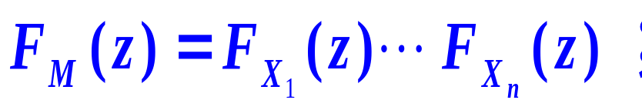
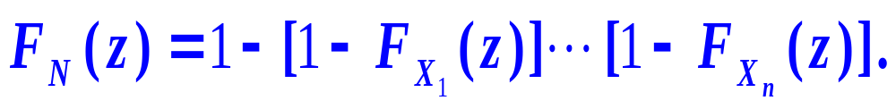
3.4.1 “Max” and “Min” function
n independent r.v. X₁, …, X_{n}
?
Find the distribution function of
1
M = max (X₁, …, X_{n} );
2
N = min (X₁, …, X_{n} ).

Slide 18
3.4.1 “Max” and “Min” function
Especially
If X₁, …, X_{n} are independent and
identically distributed,
F_{M}(z)=
[F(z)]^{n} ;
F_{N}(z)=
1-[1-F(z)]^{n} .

Slide 19
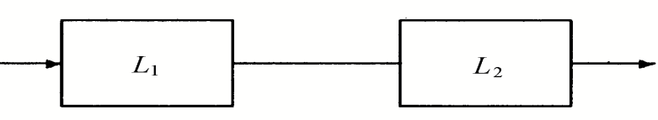
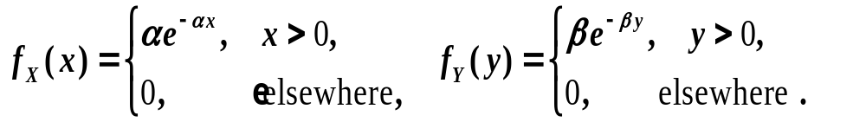
3.4.1 “Max” and “Min” function
Example
Electric Circuit
An electrical system consists of 2 independent components L₁, L_{2.}
The system works if both
L₁, L₂ work
Define the random variables X and Y as follows:
X: the life of L_{1;}
Y: the life of L_{2;}
The density distribution of X and Y are
Find the density distribution of life of the system.

Slide 20
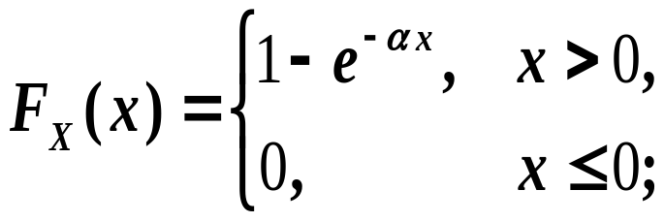
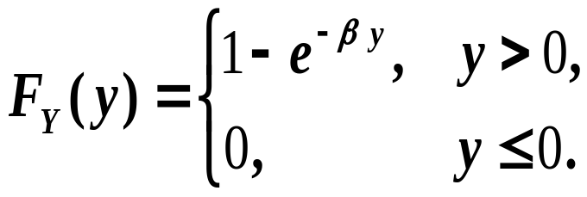
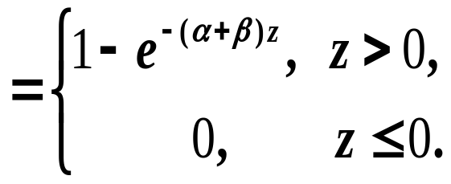
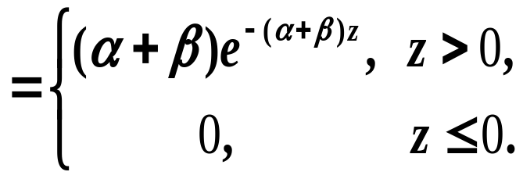
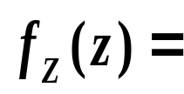
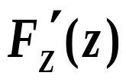
3.4.1 “Max” and “Min” function
Solve:
Z = min{X, Y}
F_{Z}(z) = 1-[1-F_{X}(z)][1-F_{Y}(z)]

Slide 21
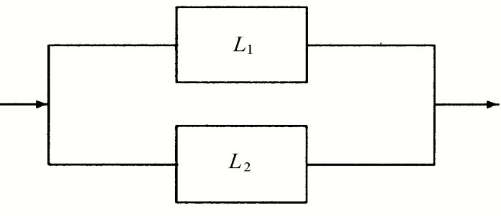
3.4.1 “Max” and “Min” function
Example
Electric Circuit
An electrical system consists of 2 independent components L₁, L_{2.}
The system works
if at least one of L₁, L₂ work
Define the random variables X and Y as follows:
X: the life of L_{1;}
Y: the life of L_{2;}
The density distribution of X and Y are
Find the density distribution of life of the system.

Slide 22
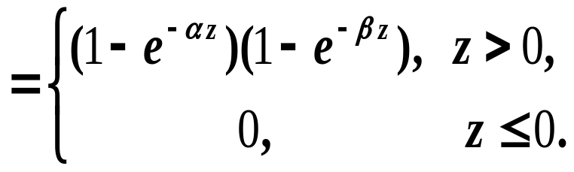
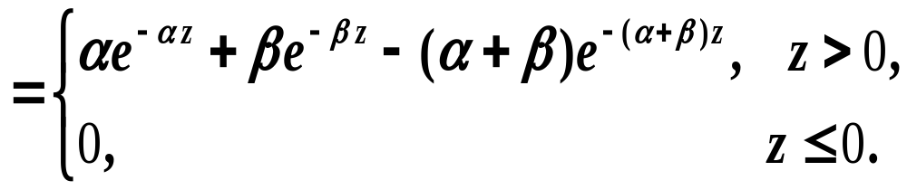
3.4.1 “Max” and “Min” function
Solve:
Z = max{X, Y}
F_{Z}(z) = F_{X}(z) F_{Y}(z)

